Slide 1
Comprehensive Analytical Dashboard of European Countries Carbon Emission
Presentation of Final Project
Advanced Programming in R [2400-DS1APR]

Slide 2

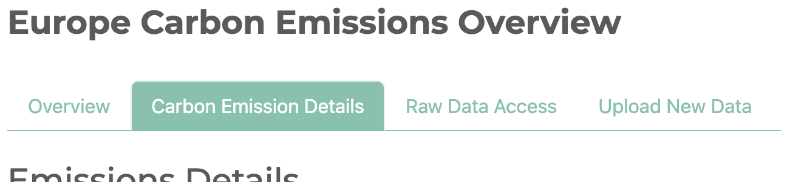
Objective & Functionalities
Objective
Europe houses some of the world’s largest and most influential economies.
Analyze Europe’s carbon emissions, given the region’s economic prominence.
Explore the environmental, economic, and policy implications of those emissions.
Data obtained from eurostat “Carbon dioxide emission footprints (FIGARO application)”
Required columns: year, countries, sector total emission
Functionalities
Emission data visualizations to explore trends and carry out comparative analysis (e.g. line plots, bar graphs, pir chat, maps)
Flexible and reproducible exploration tool:
Available for new emission data upload for future analysis
Able to filter and export data source used
Allowed to save plots / charts if available
Notes:
Emissions Data Visualization
Interactive charts (e.g., line plots, bar graphs, maps) to explore emissions trends.
Filter by:
Country or region
Sector (e.g., energy, transport, agriculture)
Time range (e.g., 1990–2023)
Comparative Analysis
Side-by-side comparisons of emissions by country or sector.
Trend detection and calculations.

Slide 3
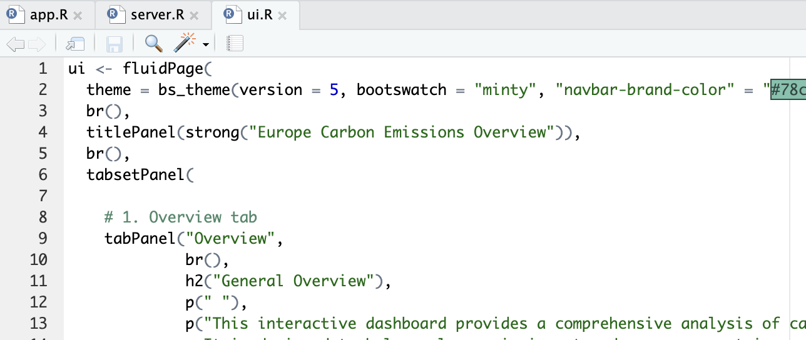
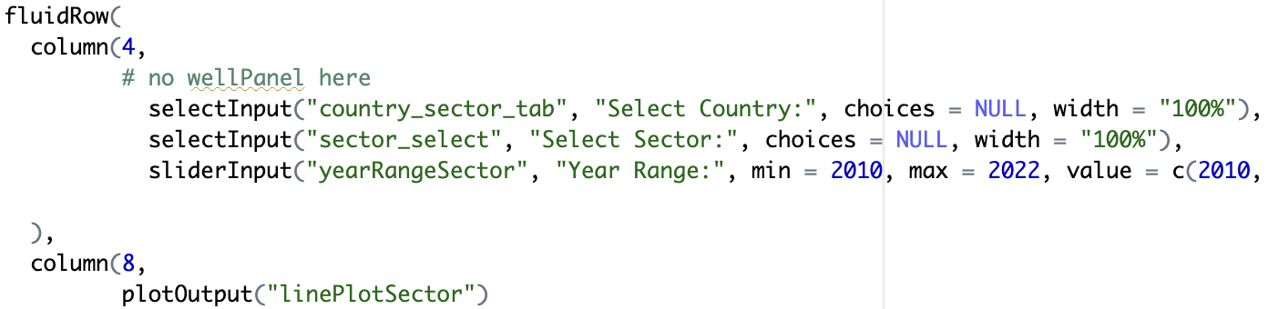
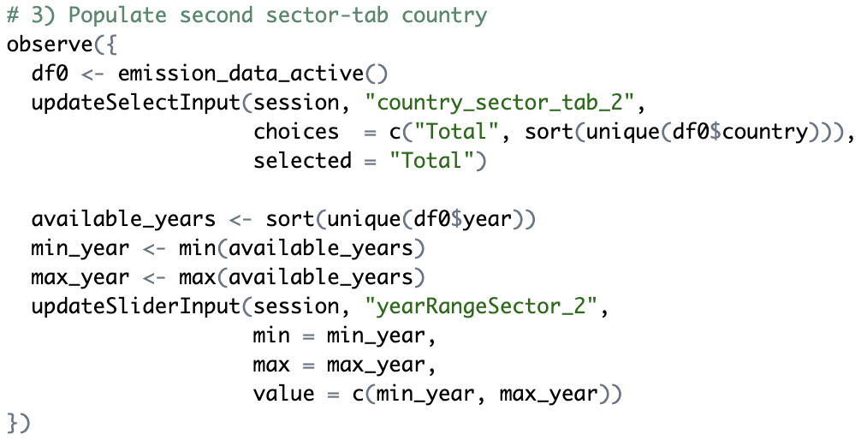
Utilisation of Coding Methods
Implementation of Interactive Web Applications using Shiny
Frontend (UI):
“tabsetPanel” and reactive inputs (sliders, dropdowns)
Backend (Server):
Reactive programming e.g. “observe”, and integrated with table / plots output like DT
Data validation workflow for new uploads
Setup (App):
For preloading necessary components
Notes:
DT for tables

Slide 4
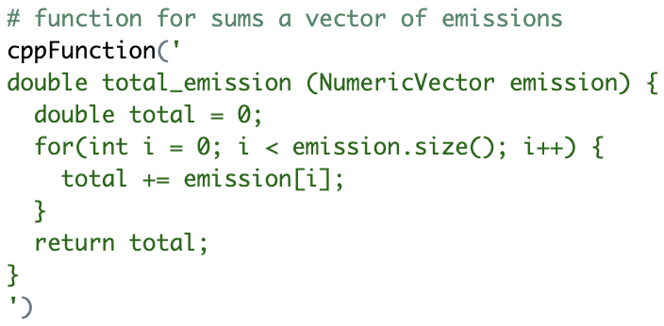
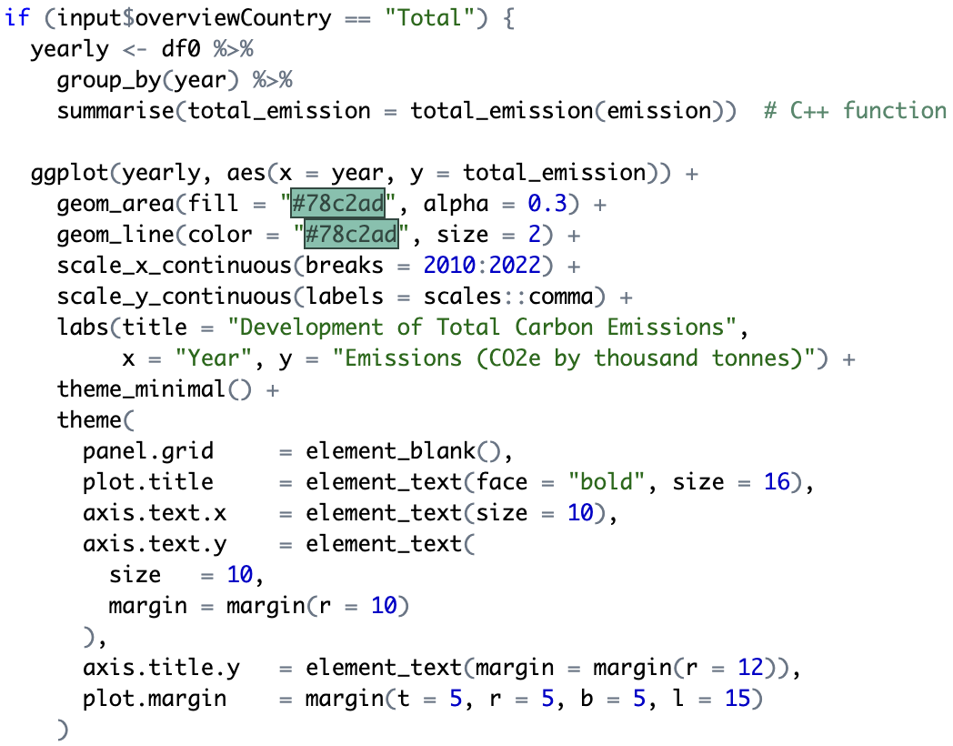
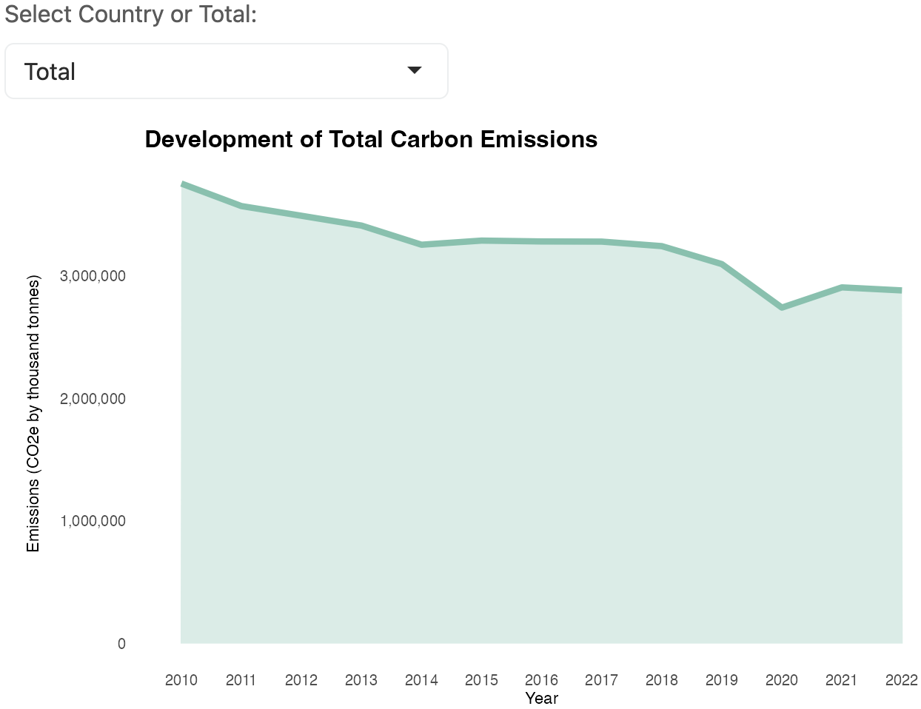
Utilisation of Coding Methods
Usage of C++ in Newly-Built Functions
Notes:
Using C++ for this simple operation might not be necessary for small data, but it can greatly improve performance for large vectors or repeated calculations inside an interactive dashboard. Optimized calculations using Rcpp (C++ integration).

Slide 5
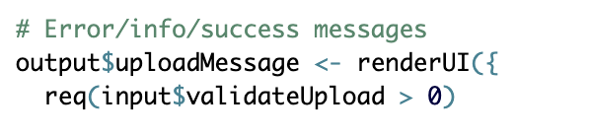
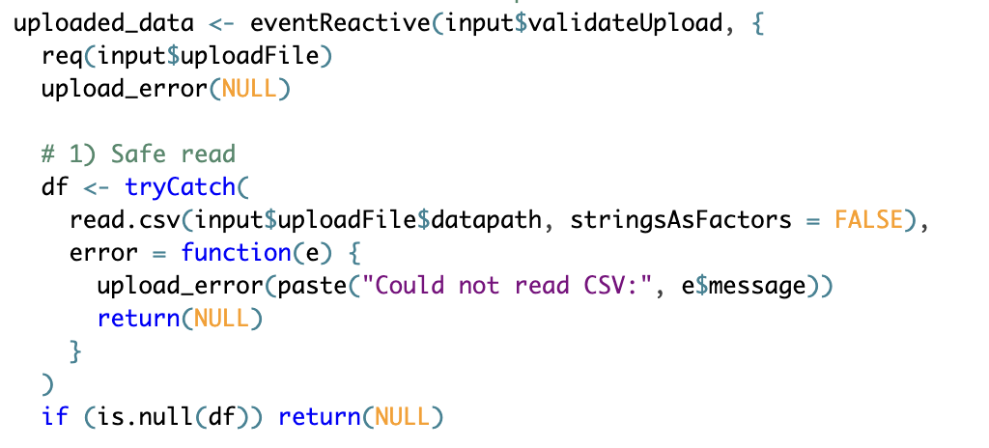
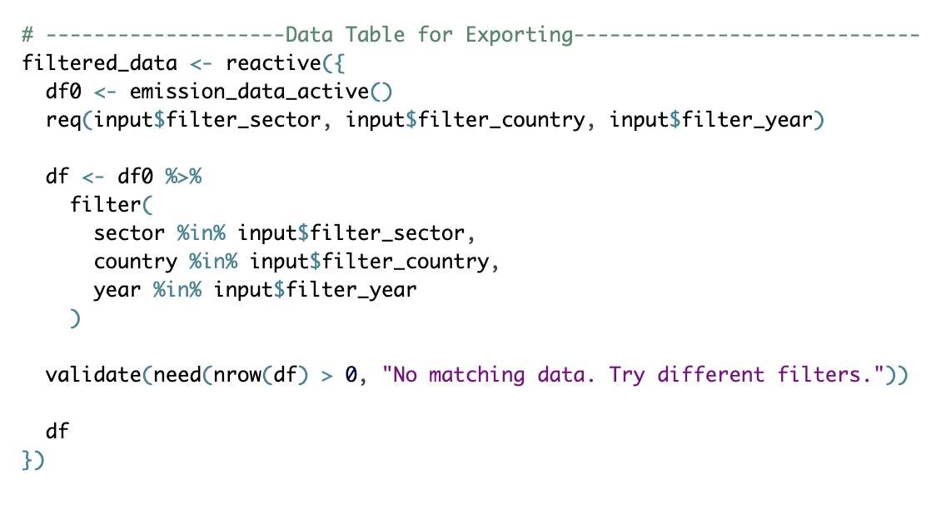
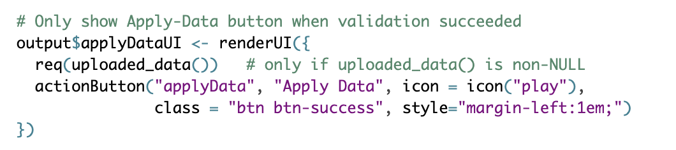
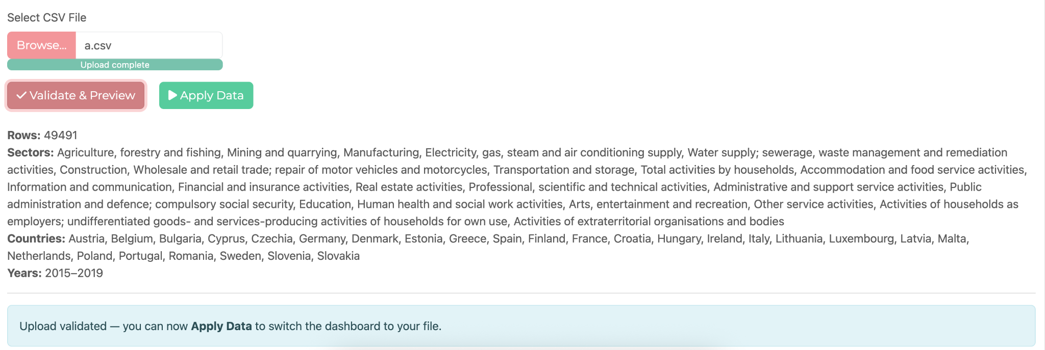
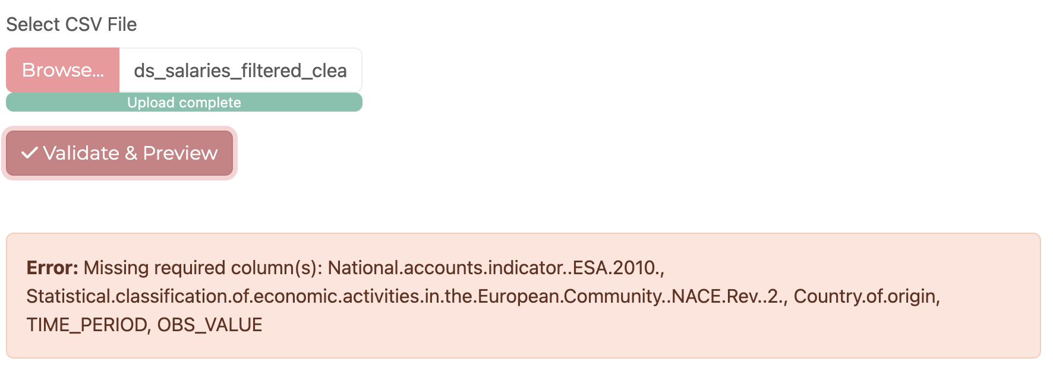
Utilisation of Coding Methods
Defensive programming methods
Input validation in each frequent use of req() and validate() functions -> stop render plot if the required inputs are wrong or unavailable
TryCatch() for error handling when importing file to check for corrupted file or different format, then returns different messages.

Slide 6
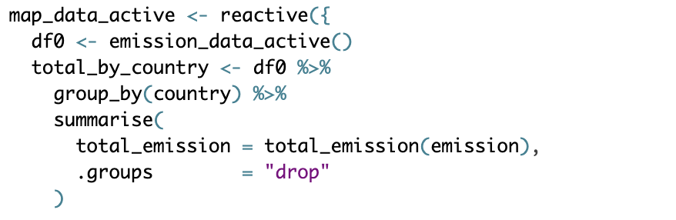
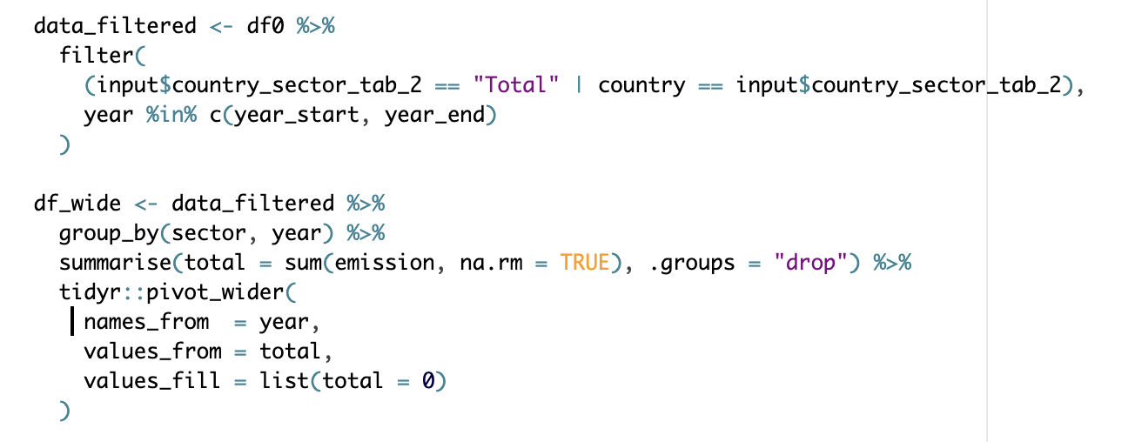
Utilisation of Coding Methods
Code vectorisation
Most of the code are vectorised as tibble using dplyr to filter each columns according to certain conditions
Minimal for-loop function for (except in C++) function

Slide 7
Short Demo
Comprehensive Dashboard of European Countries Carbon Emission
Advanced Programming in R [2400-DS1APR]

Slide 8
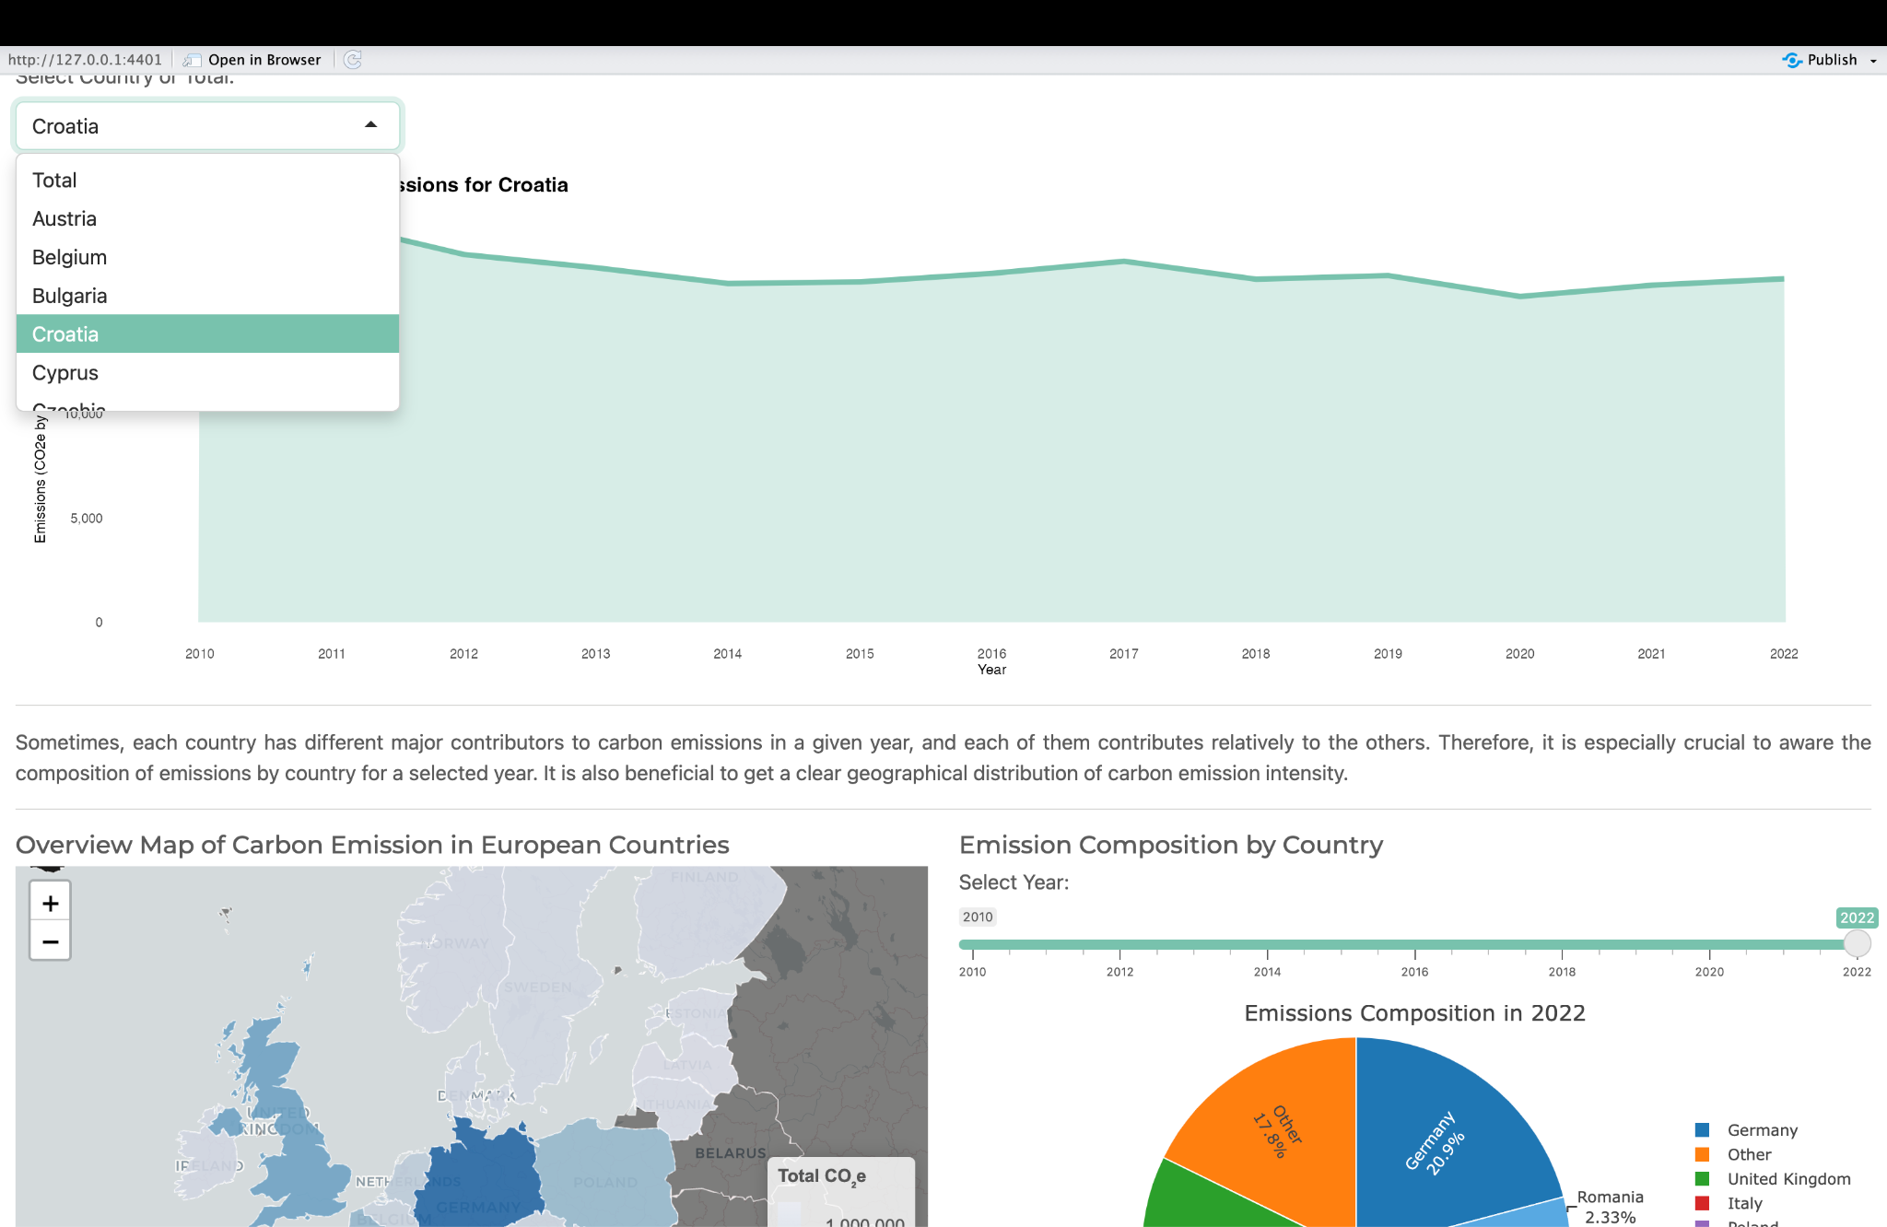

Slide 9
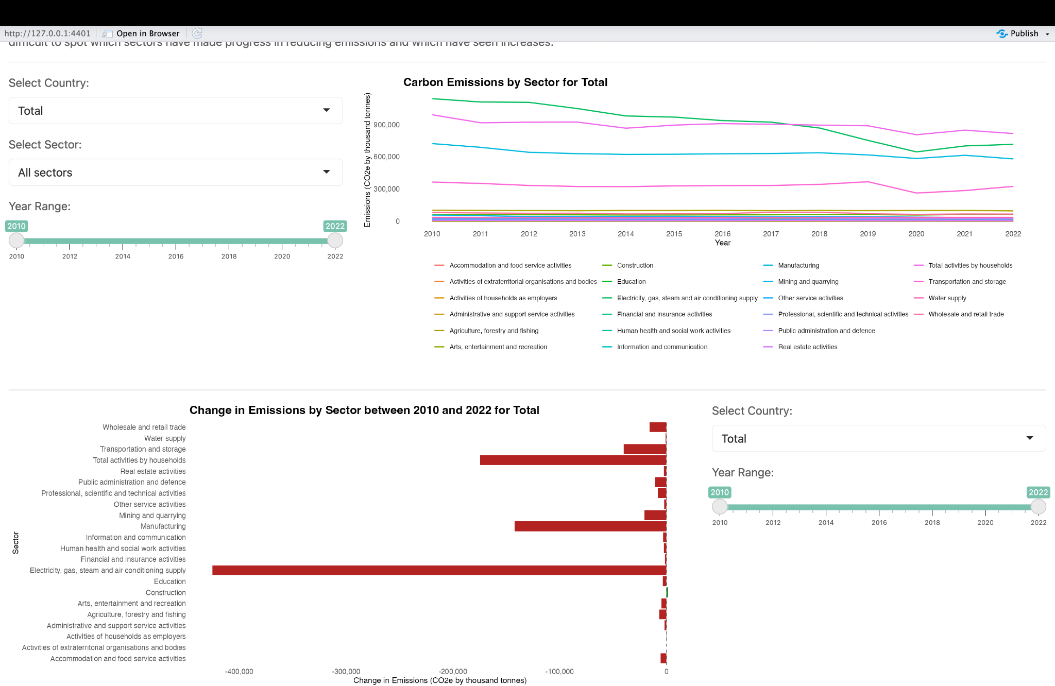

Slide 10
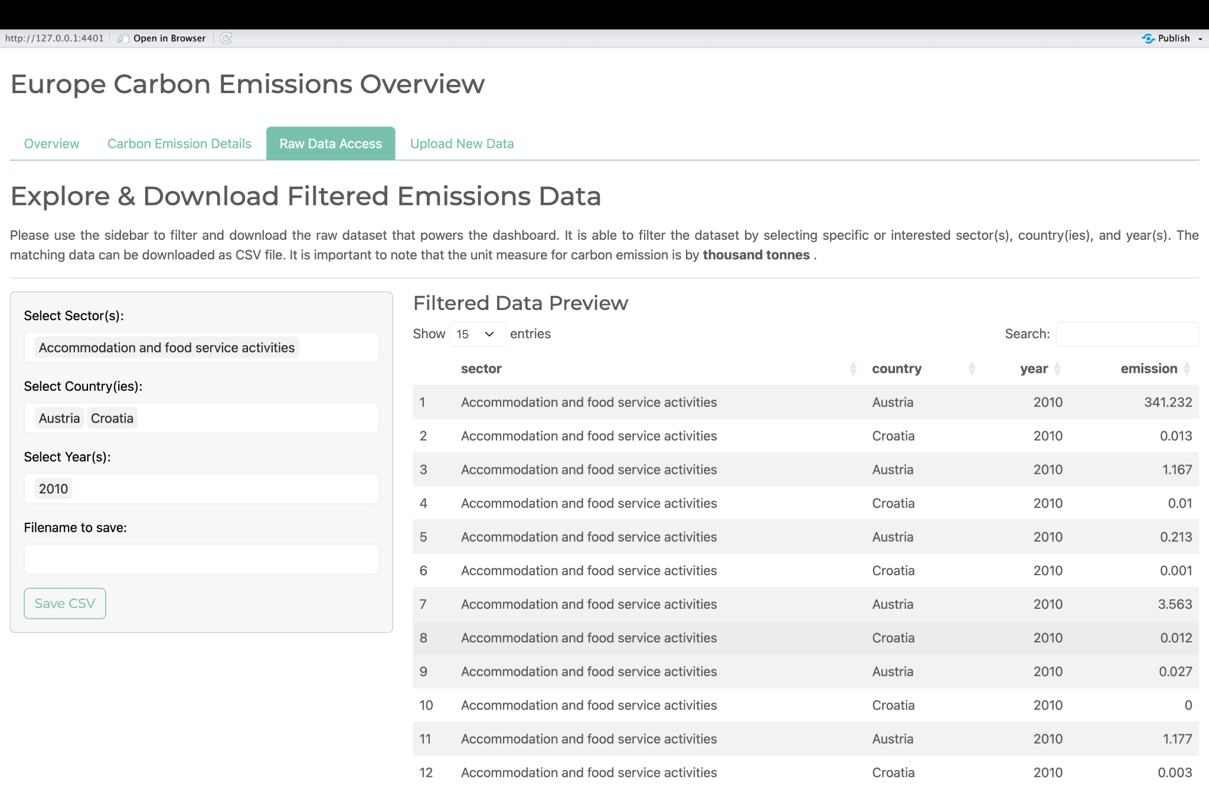

Slide 11
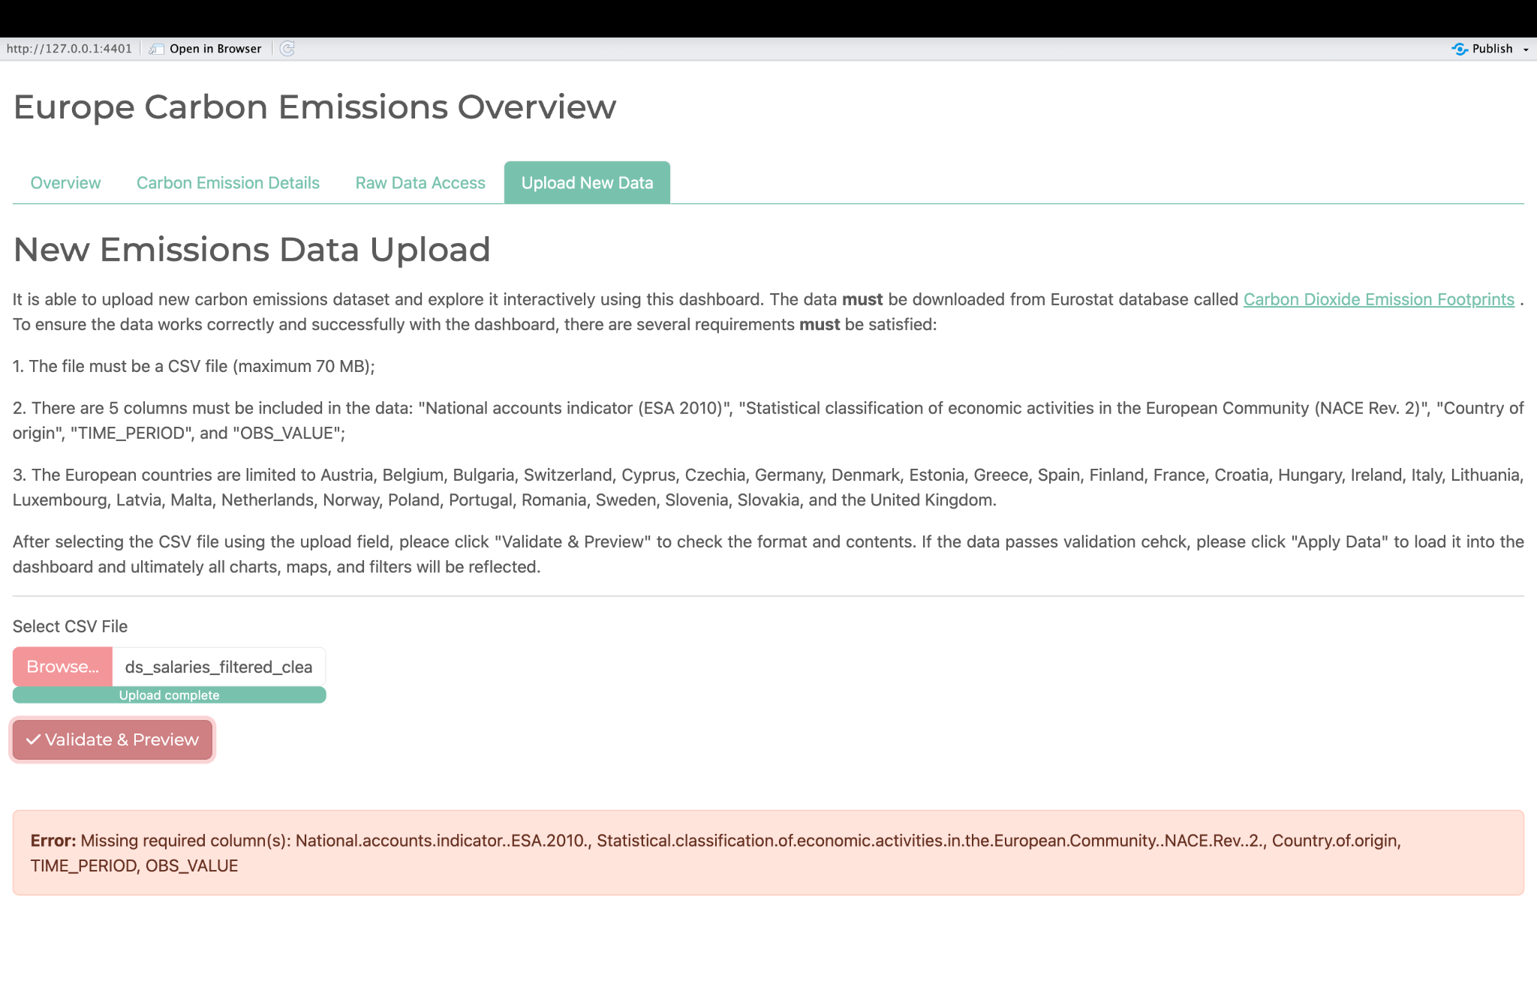

Slide 12
Thank you!
Questions?

